Slide 1
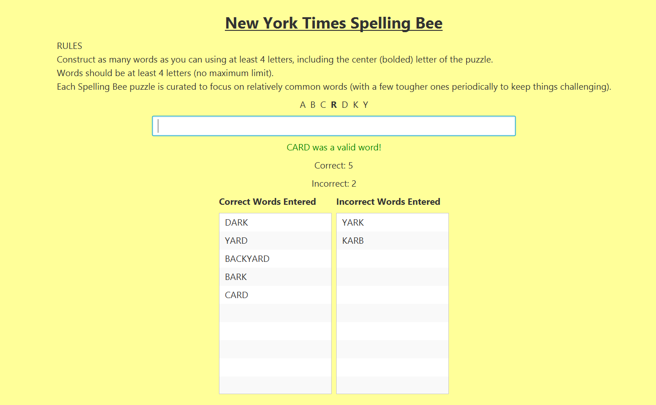
CSI 2300 Final Project
Kaden Combs & Collin Follett

Slide 2
Why Did we Build This?
The New York Times Spelling Bee is a weekly word game distributed by The New York Times since 2014!
The game is simple, the basics are that there are seven letters and you must make words using at least four of the given letters, and these words require the center letter.
We made a simple and easy to use graphical interface based on Java to allow users to locally run and play this game on their computers.

Slide 3
What our Application Can Do
Word validation and recognition
Feedback on inputted word, correct turns green, incorrect turns red, repeated word turns orange
Counter for correct and incorrect words
Displays separate lists for correct and incorrect words entered
Special recognition if user enters a pangram (word using all the letters)
Simple and easy to use graphical interface

Slide 4
Contribution
Collin: Came up with the original idea, did most of the back-end base code
Kaden: Did most of the front-end code and the JavaFX code, implementing the base code to a GUI
Both: We both improved upon the starting base code together, and brainstorming new ideas and features we could add, we both worked on the GitHub repo. Overall, we worked very well together and we are proud of what we accomplished.

Slide 5
What we Learned
Designing and programming a real-world application will probably take longer than expected!
There is a lot to learn about JavaFX when you’re just getting started
It is more efficient to have a plan for the front-end GUI before making it compared to making it and then continually changing things and having to redo the layout of everything

